Slide 1

LIBRARY MANAGEMENT SYSTEM
1
PRESENTED BY
RAJAN KUMAR(O23MCA110001)
Subject Code- 23ONMCR-753
Batch – Jul 2023
Fourth Semester
MCA DEPARTMENT CHANDIGARH UNIVERSITY

Slide 2
2
Contents
Introduction
Purpose and Objectives
System Features
Admin Functionality
Real World Application
Conclusion

Slide 3
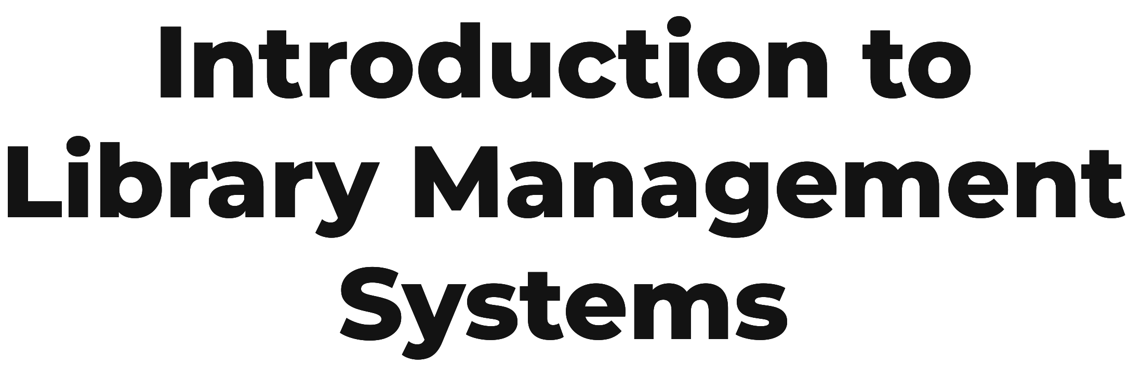

3
A Library Management System is a software designed
to handle book records, issue and return transactions,
and manage user data efficiently. It replaces manual
record-keeping, reducing errors and improving efficiency.
Fig.1

Slide 4
PURPOSE AND OBJECTIVES
4
- Simplify and digitalize library operations
- Enable secure admin and user login
- Allow users to register using phone and registration number
- Track book issuance and return for every user
- Reduce Manual workload
- Provide Efficient management system.

Slide 5

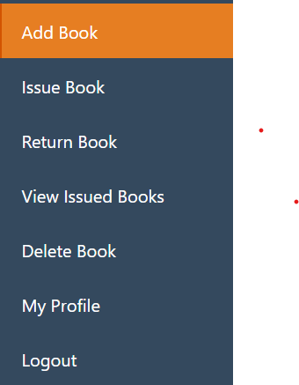
5
Admin Login
User Registration/Login
Add New Book
Issue Book
Return Book
Delete Book
Log Out
Fig. 2

Slide 6
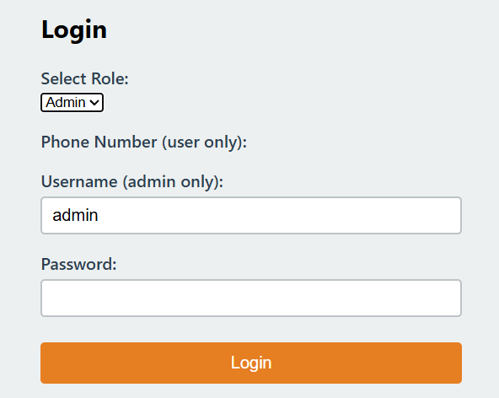

Admin Login
6
1.To perform any library function
admin login is necessary.
2.Admin has to login with username
and password
3.If credentials entered by admin is
not valid it will come up with a alert
message “Invalid user name or password”.
Fig. 3
Fig.4

Slide 7
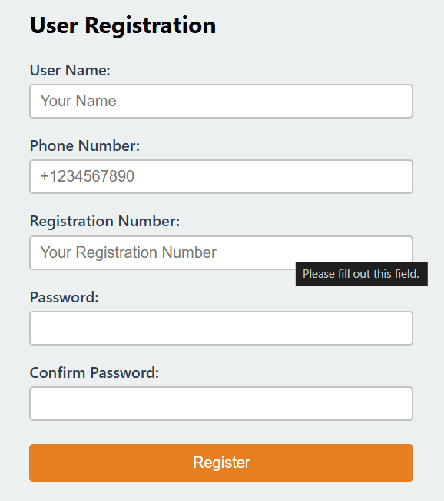

User Registration
7
New user can create their
account by clicking register section.
Here user need to enter
User name
Phone number
Registration number
Password.
For already used Registration Number
Or Phone Number it will alert the user
with alert message “Registration Number
already registered”.
Fig.5
Fig.6

Slide 8
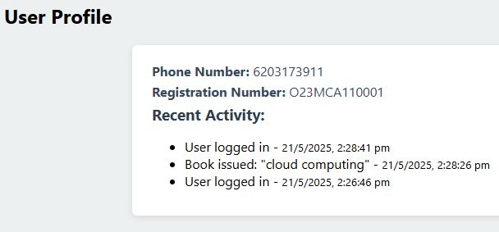
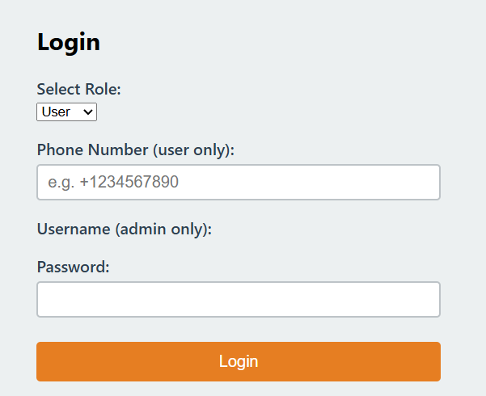
8
User Login
User have to login their account
by entering valid credentials.
Fig.7
After successful login, user profile will be visible that
Contains:-
User Information(Name, Phone No., Reg no.) and
User’s activity.
Fig.8

Slide 9
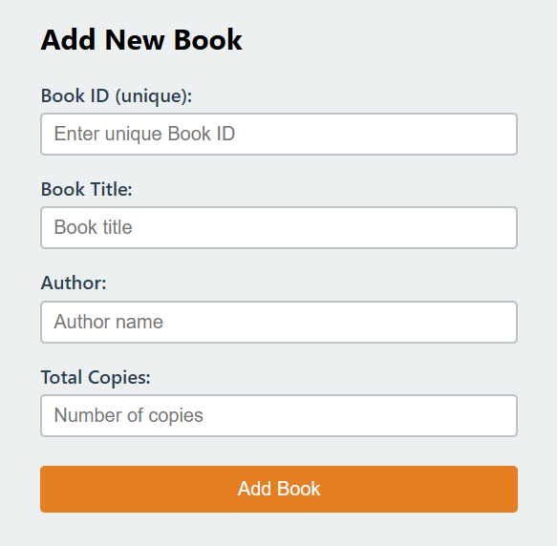
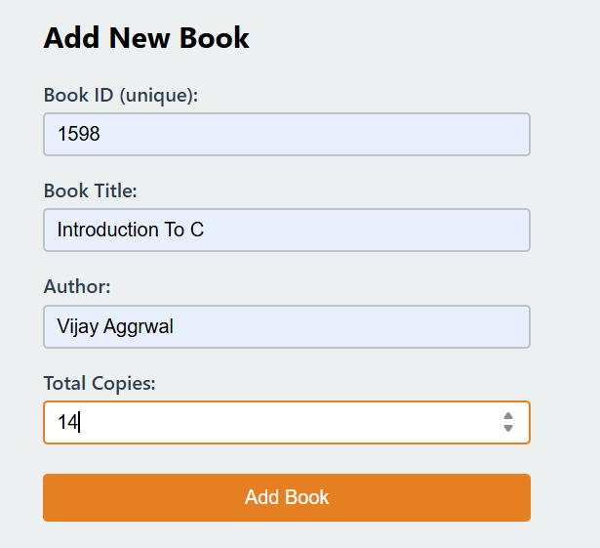

9
Add New Book
Fig.9
:- Only admin can add new book
:- While adding book admin need to insert
1.Book Title
2.Author Name
3.Number of copies
After each successful addition it shows alert message of “Book Added Successfully” with book ID.
Fig.10
Fig.11

Slide 10
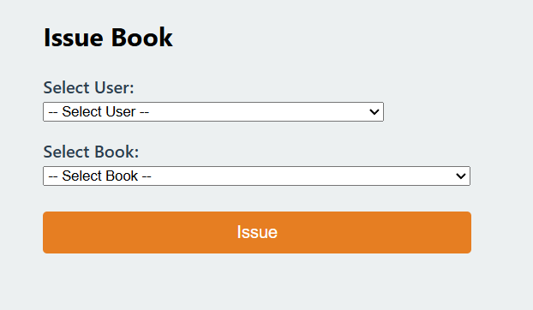
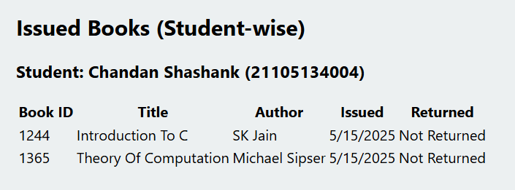
10
Issue Book
Issued book section
This section will show issued book(student wise) with issued date and return date.
Fig.13
Admin will issue book to user by:
Select a user
Select book
Issue
Fig.12

Slide 11
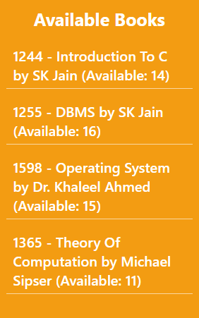
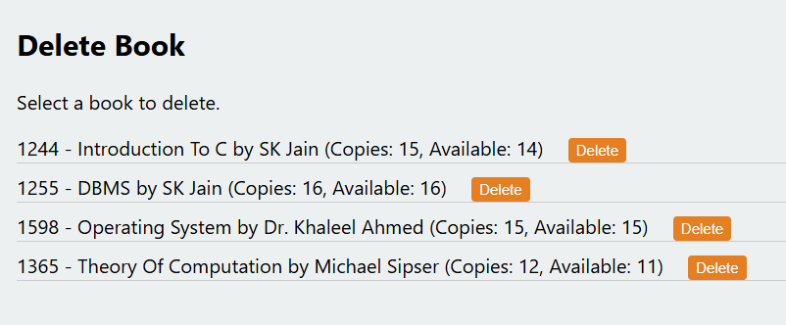
Available book
Delete Book
11
Admin can delete any book from library if
the book is no longer available or there is
no use of a particular book by clicking the
delete button in “Delete Book” section.
Available book section is always visible to both user and admin.
It shows all the books with number of copies available in the library .
Fig.15
Fig.14

Slide 12
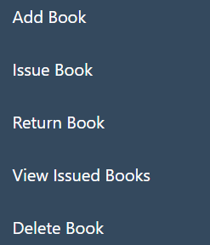
12
Admin Functionalities
- Add new books with unique Book ID
- View, issue, and delete books
- Track issued books student-wise
- Access dashboard and perform book operations
Fig.16

Slide 13

13
Real World Application
- School and college libraries
- Digital archives and documentation systems
- Online educational resource platforms
- Community and public libraries
- Book rental and lending startups
Fig.17

Slide 14
Conclusion
14
The Library Management System is an efficient and user-friendly solution for managing library operations digitally. It automates book tracking, issuing, and returning, reducing manual errors and improving accessibility.
With secure admin login, real-time book availability updates, and data persistence, this system enhances the overall management process.

Slide 15
References
15
fig.2 to fig. 16 has been taken from the website itself.
Fig.17 has been taken from www.skill.lync.com
Fig.1 taken from www.thebestcolleges.org

Slide 16
Thanks!
16

